Slide 1
Data Link Layer Medium Access Control
LECTURE 06

Slide 2
Content
Medium Access Control
Definition
Multiple Access
Carrier Sensing Multiple Access (CSMA)
CSMA
CSMA/CD (Collision Detection)
IEEE 802.3 Ethernet Half-duplex mode
CSMA/CA (Collision Avoidance)
IEEE 802.11 (Wireless LAN)
IEEE 802.15.4 (Wireless Sensor Network)

Slide 3
Data Link Layer functions
Frame
The unit of data to be sent by a DLL protocol
Addressing
Identifying an entity on the DLL network
Data transfer
Medium access control
Accessing the physical medium to transmit frames
Flow control
Controlling the transmission speed of a sender
Error control
Detecting and correcting transmission errors
Management
Maintaining the data link layer

Slide 4
IEEE 802.3-2022 4. Media Access Control 4.1 Functional model of the MAC method
The MAC sublayer defines a medium-independent facility, built on the medium-dependent physical facility provided by the Physical Layer, and under the access-layer-independent LAN LLC sublayer (or other MAC client (MAC bridge)).
The LLC sublayer and the MAC sublayer together are intended to have the same function as that described in the OSI model for the Data Link Layer alone.

Slide 5
IEEE 802.3-2022 4. Media Access Control 4.1 Functional model of the MAC method
The partitioning of functions [presented in this standard] requires two main functions [generally associated with a data link control procedure] to be performed in the MAC sublayer.
They are as follows:
a) Data encapsulation (transmit and receive)
1) Framing (frame boundary delimitation, frame synchronization)
2) Addressing (handling of source and destination addresses)
3) Error detection (detection of physical medium transmission errors)
b) Media Access Management
1) Medium allocation (collision avoidance)
2) Contention resolution (collision handling)

Slide 6
IEEE 802.3-2022 4. Media Access Control 4.1 Functional model of the MAC method
An optional MAC control sublayer, [architecturally positioned between LLC (or other MAC client) and the MAC], is specified in Clause 31 MAC Control.
This MAC Control sublayer is transparent to both the underlying MAC and its client (typically LLC).
The MAC sublayer operates independently of its client; i.e., it is unaware whether the client is LLC or the MAC Control sublayer.
This allows the MAC to be specified and implemented in one manner, whether or not the MAC Control sublayer is implemented.

Slide 7
IEEE 802 Standards for Medium Access Control

Slide 8
IEEE 802 Standards for Medium Access Control
IEEE 802.3-2022
IEEE Standard for Ethernet
IEEE 802.11-2020 (& IEEE 802.11ax-2021)
Part 11: Wireless LAN Medium Access Control (MAC) and Physical Layer (PHY) Specifications
IEEE 802.15.4-2020
IEEE Standard for Low-Rate Wireless Networks

Slide 9
Medium Access Control IEEE 802.3-2022 Ethernet
Abstract
Ethernet local area network operation is specified for selected speeds of operation from 1 Mb/s to 400 Gb/s using a common media access control (MAC) specification and management information base (MIB).
The Carrier Sense Multiple Access with Collision Detection (CSMA/CD) MAC protocol specifies shared medium (half duplex) operation, as well as full duplex operation.

Slide 10
Medium Access Control IEEE 802.3-2020 Ethernet
Abstract
Speed specific Media Independent Interfaces (MIIs) allow use of selected Physical Layer devices (PHYs) for operation over coaxial, twisted pair or fiber optic cables, or electrical backplanes.
System considerations for multi-segment shared access networks describe the use of Repeaters [that are defined for operational speeds up to 1000 Mb/s].
Local Area Network (LAN) operation is supported at all speeds.
Other specified capabilities include: various PHY types for access networks, PHYs suitable for metropolitan area network applications, and the provision of power over selected twisted pair PHY types.

Slide 11
Medium Access Control IEEE 802.11-2020 WLAN
Scope:
The scope of this standard is to define one medium access control (MAC) and several physical layer (PHY) specifications for wireless connectivity for fixed, portable, and moving stations (STAs) within a local area.
Purpose
The purpose of this standard is to provide wireless connectivity for fixed, portable, and moving stations within a local area.
This standard also offers regulatory bodies a means of standardizing access to one or more frequency bands for the purpose of local area communication.

Slide 12
Medium Access Control IEEE 802.15.4-2020 Low-Rate Wireless Networks
Scope
This standard defines the physical layer (PHY) and medium access control (MAC) sublayer specifications for low-data-rate wireless connectivity with fixed, portable, and moving devices with no battery or very limited battery consumption requirements.
In addition, the standard provides modes that allow for precision ranging.

Slide 13
Medium Access Control IEEE 802.15.4-2020 Low-Rate Wireless Networks
Purpose
The standard provides for ultra low complexity, ultra low cost, ultra low power consumption, and low data rate wireless connectivity among inexpensive devices, especially targeting the communications requirements of what is now commonly referred to as the Internet of Things.
In addition, some of the alternate PHYs provide precision ranging capability that is accurate to one meter.
Multiple PHYs are defined to support a variety of frequency bands.

Slide 14
Medium Access Control Multiple Access

Slide 15
Medium Access Control Multiple Access
Multiple Access
Sharing a high-speed common medium by multiple devices
Multiple Access requires a coordination function to schedule which device access the medium at a specific time.
Single User (SU): A single device gets a right to access the medium at a time
Multi-User (MU): Multiple devices get a right to access the medium at a time
IEEE 802.11ax-2021
Uplink/Downlink MU-MIMO (Multiple Input Multiple Output)
Uplink/Downlink MU-OFDMA (Orthogonal Frequency Division Multiple Access)

Slide 16
Medium Access Control Multiple Access Strategy
Distributed coordination
No central coordinator
Distributed algorithm
Contention-based
Centralized coordination
A central coordinator
Reservation-based
Hybrid coordination
Distributed coordination and
Centralized coordination

Slide 17
Medium Access Control Multiple Access Strategy
Distributed coordination
(Distributed Coordination Function (DCF) (non-QoS STA)
(HCF enhanced distributed channel access (EDCA) – HT/VHT/HE STA)
(Contention-based access period (DMG STAs))
(Carrier sense multiple access with collision avoidance (CSMA-CA))
Devices compete the access right of the medium
Random Access / Contention-based
It requires a method to avoid access conflicts
The winning device uses the medium exclusively during a pre-defined period of time
The transmission time of a maximum-size single packet and its acknowledgement if required or
Transmission Opportunity (TXOP)
HCF hybrid coordination function

Slide 18
Medium Access Control Multiple Access Strategy
Centralized coordination
(HCF controlled channel access (HCCA) – HT/VHT/HE STA)
(SPCA service period channel access (SP/SPCA) – DMG STA)
The resource of the shared medium is partitioned into units
Each device requests a reservation for resource units to a coordinator
The coordinator allocates requested (or reduced) amount of resource units and/or the amount of time to be used by the requester if the resource are available
The granted device uses the resource units during an allocated period of time
HCF hybrid coordination function

Slide 19
Medium Access Control Multiple Access Strategy
Hybrid Coordination Function (HCF)
(HEMM HCCA, EDCA mixed mode – HT/VHT/HE STA)
(Dynamic Allocation – (sharing CBAP or SP) – DMG STA)
The access time of the medium is divided into two periods
Contention-free period
A central coordinator
Contention period
Distributed coordination
These periods are usually controlled by a central coordinator

Slide 20
Carrier Sense Multiple Access
CSMA
CSMA/CD
CSMA/CA

Slide 21
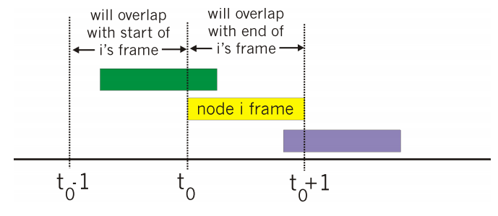
Carrier-sense multiple access (CSMA) Aloha and Slotted Aloha
Aloha
Operation
When a sender have data, it sends data.
If data doesn’t get through, then data are retransmitted after a random delay.
The receiver sends acknowledgement.
Problem
Aloha transmits even if another host is transmitting.
collision

Slide 22
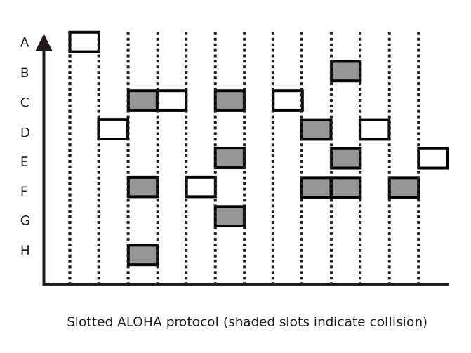
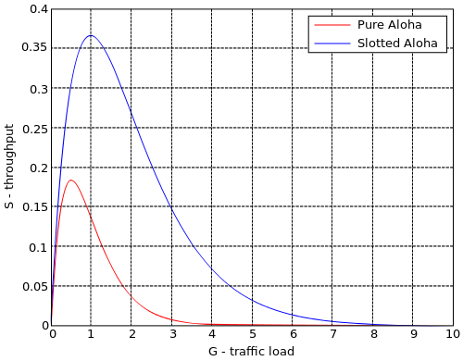
Carrier-sense multiple access (CSMA) Aloha and Slotted Aloha
Slotted Aloha
Time is divided into equal size slots (frame size)
Operation
A device wanting to transmit starts at start of next slot
Time synchronization between devices
Only transmission-attempts within 1 frame-time

Slide 23
Carrier-sense multiple access (CSMA)
Carrier-sense multiple access (CSMA)
A sender verifies the absence of other traffic before transmitting on a shared transmission medium.
If the medium is busy, the sender waits for the transmission in progress to end before initiating its own transmission.

Slide 24
Carrier-sense multiple access (CSMA) CSMA access modes
1-persistent
IEEE 802.3 Ethernet CSMA/CD (half-duplex operation).
Operation
When the sender is ready to transmit data, it senses the transmission medium for idle or busy.
If idle, then it transmits immediately.
If busy, then it senses the transmission medium continuously until the medium becomes idle.
It transmits data unconditionally after the medium becomes idle.
In case of a collision is detected during transmitting data, the sender waits for a random period of time before attempting data transmission.
Problem
Multiple senders may try to send when the medium becomes idle.
They definitely collide.

Slide 25
Carrier-sense multiple access CSMA access modes
Non-persistent
IEEE 802.15.4 LR-WN CSMA-CA.
Operation
When the sender is ready to transmit data, it senses the transmission medium for idle or busy.
If idle, then it transmits immediately.
If busy, then it waits for a random period of time before attempting data transmission.
It transmits data unconditionally after the random period of time if the medium is idle.
Problem
This method may cause long transmission delay after the medium becomes idle.

Slide 26
Carrier-sense multiple access CSMA access modes
P-persistent
Operation
When the sender is ready to transmit data, it senses the transmission medium for idle or busy.
If idle, then it transmits immediately.
If busy, then then it senses the transmission medium continuously until the medium becomes idle.
The sender transmits with probability p after the medium becomes idle.
This probabilistic hold-off repeats until the frame is finally transmitted.

Slide 27
Carrier Sense Multiple Access with Collision Detection (CSMA/CD)
IEEE802.3 Ethernet half-duplex mode

Slide 28
Carrier-sense multiple access (CSMA) IEEE 802.3-2020 Ethernet Carrier Sense Multiple Access with Collision Detection (CSMA/CD)
This standard provides for two modes of operation of the MAC sublayer:
a) In half duplex mode, stations contend for the use of the physical medium, using the CSMA/CD algorithms specified.
b) The full duplex mode of operation can be used when all of the following are true:
1) The physical medium is capable of supporting simultaneous transmission and reception without interference.
2) There are exactly two stations on the LAN.
This allows the physical medium to be treated as a full duplex point-to-point link between the stations.
Since there is no contention for use of a shared medium, the multiple access (i.e., CSMA/CD) algorithms are unnecessary.
3) Both stations on the LAN are capable of and have been configured to use full duplex operation.

Slide 29
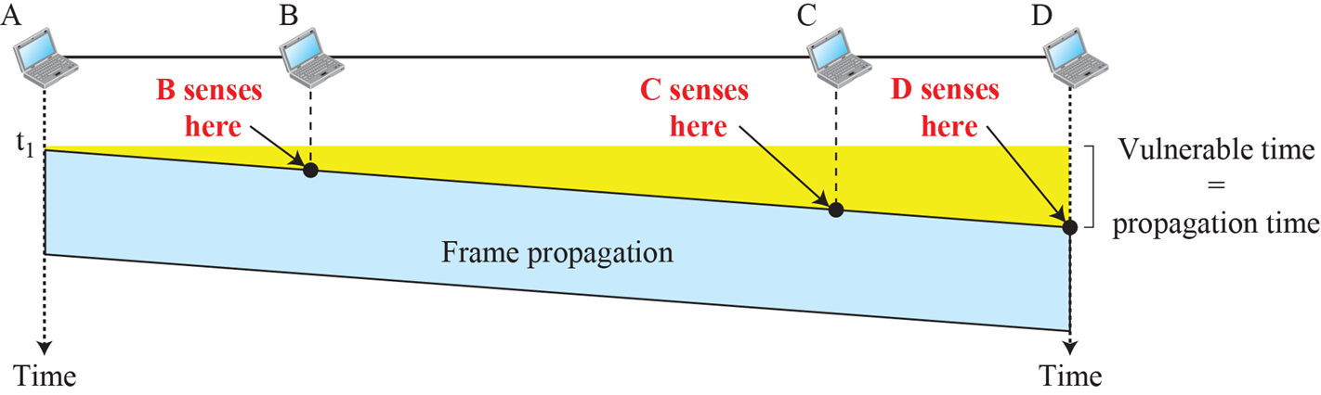
CSMA/CD Collision Detection (CD)
(Worst-cast) Vulnerable time
The propagation time between a pair of stations, which have the longest distance in the link

Slide 30
CSMA/CD Collision Detection (CD)
Collision Detection (CD)
When a transmitter sends a frame, it receives its frame simultaneously.
If two signals differ, there is a collision on the link
The collision detection time = 2 * (the propagation time)
the propagation time = the signal travelling time between two station, of which frames are collided

Slide 31
CSMA/CD Collision Detection (CD)
Collision handling procedure
The transmitter
stops transmitting the frame,
transmits a jam signal for the minimum packet time
It ensures [that all receivers (attached to the link) detect the collision].
After the minimum packet time, the medium becomes idle.
Selects a random time from a random time interval
If the collision occurs first time, the random time interval set to the default interval
Otherwise, the random time interval = 2* the random time interval
Waits aSlotTime*the random time before trying to resend the frame.
The aSlotTime is predefined in the standard.

Slide 32
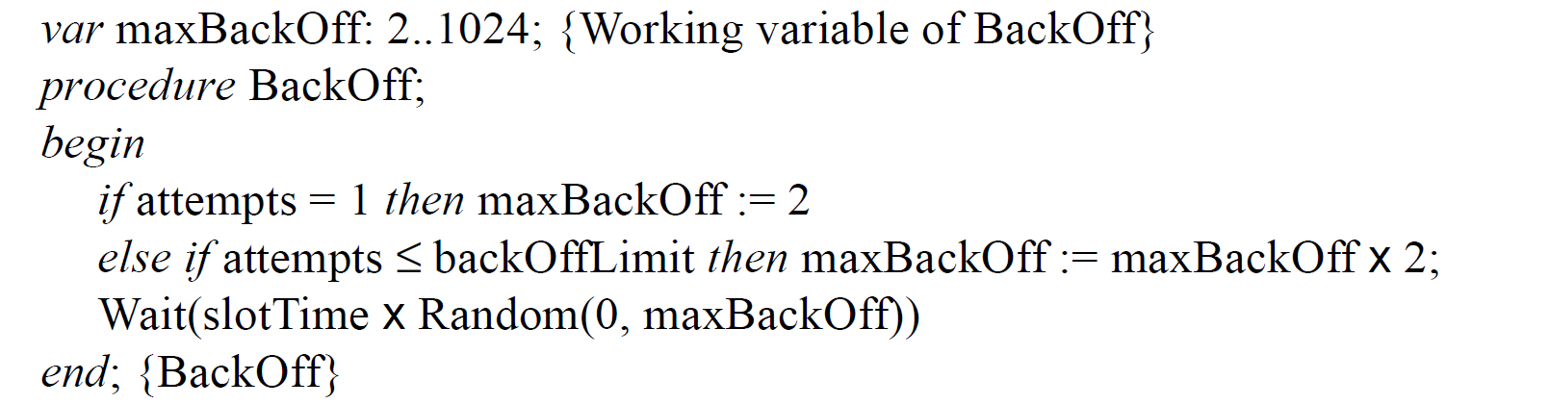
CSMA/CD Random Backoff Procedure
IEEE Std 802.3-2022 Table 4-2 (only for MAC data rate≤1Gbps, [MAC data rate≥ 10Gbps: Full duplex])
aSlotTime = 512-bit times for up to 100Mbps, 4096-bit times for 1Gbps.
jamSize = 32 bits; jam signal = 1010 1010 ….; backOffLimit = 10
minFrameSize: 512 bits (64 octets)
interPacketGap(interFrameSpacing): 96bits
The maximum allowed diameter of an Ethernet installation is limited to 232 bits.
This makes a round-trip-time of 464 bits.
The slot time in Ethernet is 512 bits.

Slide 33
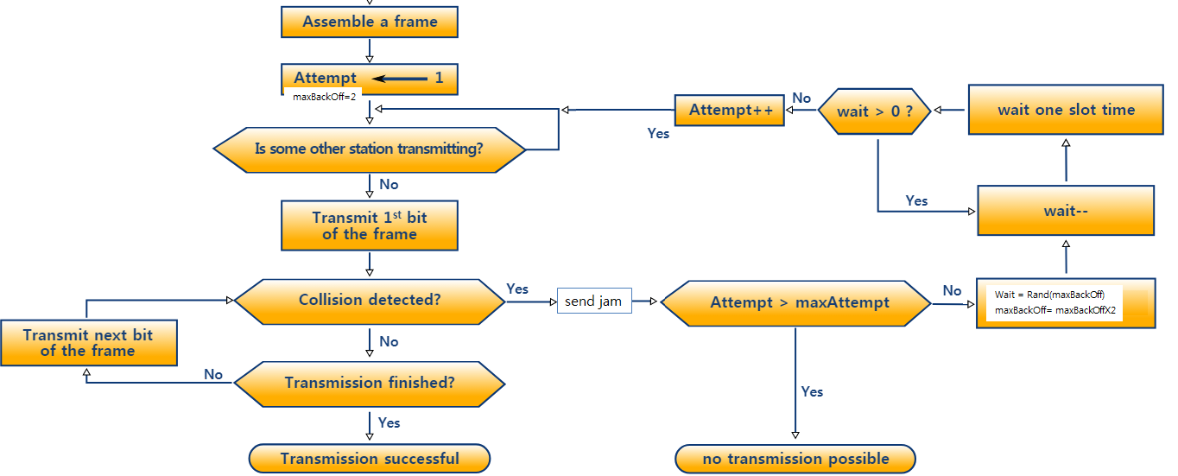
CSMA/CD CSMA/CD Algorithm
Random backoff procedure
- Wait(aSlotTime*wait)
1-persistent

Slide 34
IEEE 802.3-2022 Ethernet 4.1.2 CSMA/CD operation 4.1.2.1.1 Transmission without contention (half duplex)
When a MAC client requests the transmission of a frame, the Transmit Data Encapsulation component of the CSMA/CD MAC sublayer constructs the frame from the client-supplied data (EPD format).
It prepends a preamble and a Start Frame Delimiter to the beginning of the frame.
Using information provided by the client, the CSMA/CD MAC sublayer also appends a Pad at the end of the MAC information field of sufficient length to ensure that the transmitted frame length satisfies a minimum frame-size requirement (64octets).
It also prepends destination and source addresses, the length/type field, and appends a frame check sequence to provide for error detection.

Slide 35
IEEE 802.3-2022 Ethernet 4.1.2 CSMA/CD operation 4.1.2.1.1 Transmission without contention (half duplex)
The frame is then handed to the Transmit Media Access Management component in the MAC sublayer for transmission.
Transmit Media Access Management attempts to avoid contention with other traffic on the medium by monitoring the carrier sense signal provided by the Physical Layer Signaling (PLS) component and deferring to passing traffic.
When the medium is clear, frame transmission is initiated (after a brief interframe delay (interPacketGap(96bits))

Slide 36
IEEE 802.3-2022 Ethernet 4.1.2 CSMA/CD operation 4.1.2.1.1 Transmission without contention (half duplex)
The MAC sublayer then provides a serial stream of bits to the Physical Layer for transmission.
(1GMb/s only) the minimum frame size is insufficient to ensure the proper operation of the CSMA/CD protocol for the desired network topologies.
The MAC sublayer will append a sequence of extension bits to frames which are less than aSlotTime (4096) bits in length.
(1GMb/s only) the CSMA/CD MAC may optionally transmit additional frames without relinquishing control of the transmission medium, up to a specified limit.

Slide 37
IEEE 802.3-2022 Ethernet 4.1.2 CSMA/CD operation 4.1.2.1.1 Transmission without contention (half duplex)
The Physical Layer performs the task of generating the signals on the medium [that represent the bits of the frame].
Simultaneously, it monitors the medium and generates the collision detect signal, which (in the contention-free case under discussion,) remains off for the duration of the frame.
When transmission has completed without contention, the CSMA/CD MAC sublayer so informs the MAC client and awaits the next request for frame transmission.

Slide 38
Carrier Sense Multiple Access with Collision Avoidance (CSMA/CA)
IEEE802.11 Wireless LAN
IEEE 802.15.4 Low-Rate
Wireless Networks

Slide 39
Carrier Sense Multiple Access with Collision Avoidance (CSMA/CA) in IEEE standards
IEEE Std 802.11-2020
DCF (Distributed Coordination Function)
Carrier Sense Multiple Access with Collision Avoidance (CSMA/CA)
HCF (Hybrid Coordination Function):
Enhanced Distributed Channel Access (EDCA)
IEEE Std 802.15.4-2020
6.2.5 Random access methods
CSMA-CA algorithm

Slide 40
CSMA/CA Wireless Media (WM) PHYs
Wireless PHYs are significantly less reliable than wired PHYs.
Multipath : time-varying and asymmetric propagation properties
Interference from other signals that may be sharing the medium
interference from logically disjoint IEEE 802.11 networks operating in overlapping areas (Overlapping Basic Service Set)

Slide 41
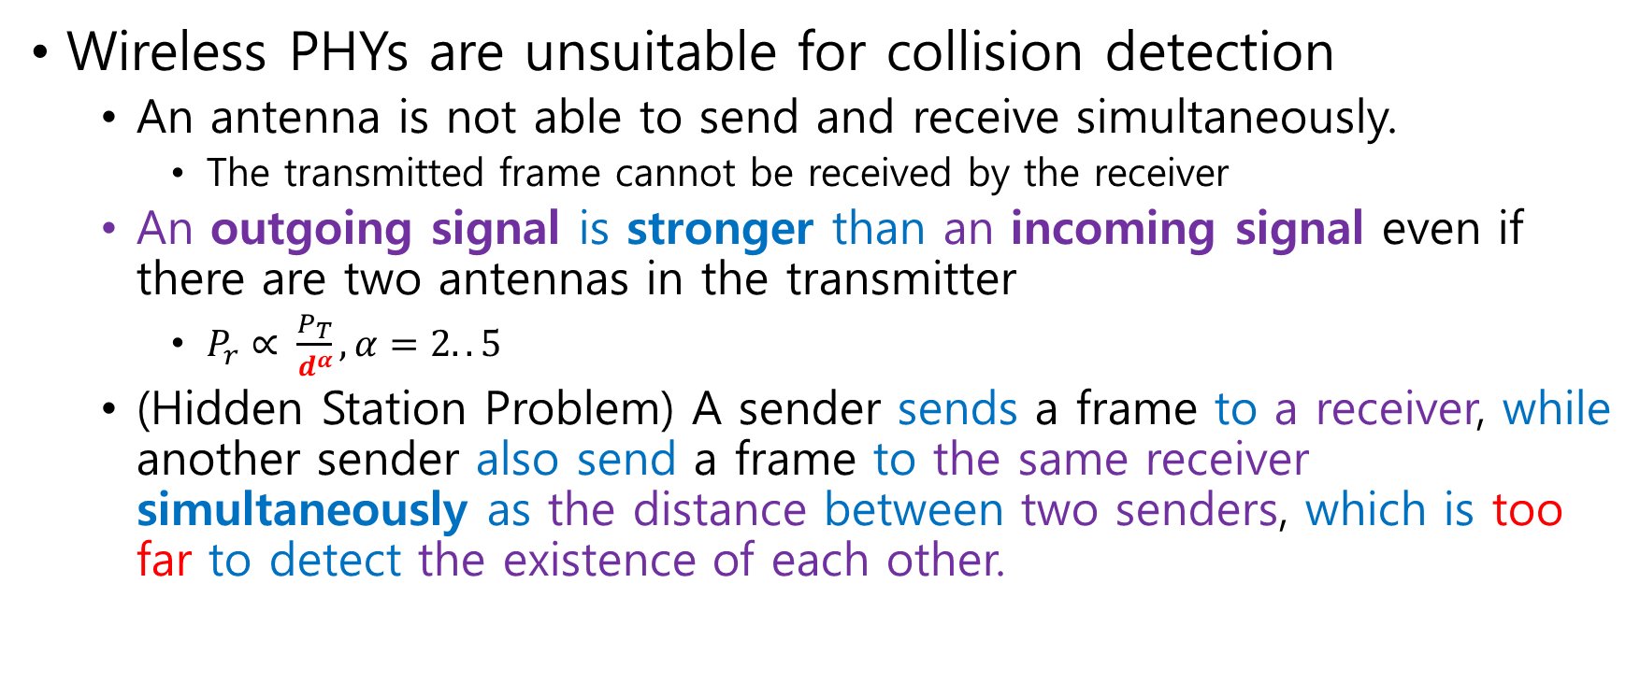
CSMA/CA Wireless Media (WM) PHYs
Wireless PHYs are unsuitable for collision detection
An antenna is not able to send and receive simultaneously.
The transmitted frame cannot be received by the receiver
An outgoing signal is stronger than an incoming signal even if there are two antennas in the transmitter
$P_{r}∝ \frac{P_{T}}{d^{α}}, α=2..5$
(Hidden Station Problem) A sender sends a frame to a receiver, while another sender also send a frame to the same receiver simultaneously as the distance between two senders, which is too far to detect the existence of each other.

Slide 42
IEEE802.11 Wireless LAN CSMA/CA

Slide 43
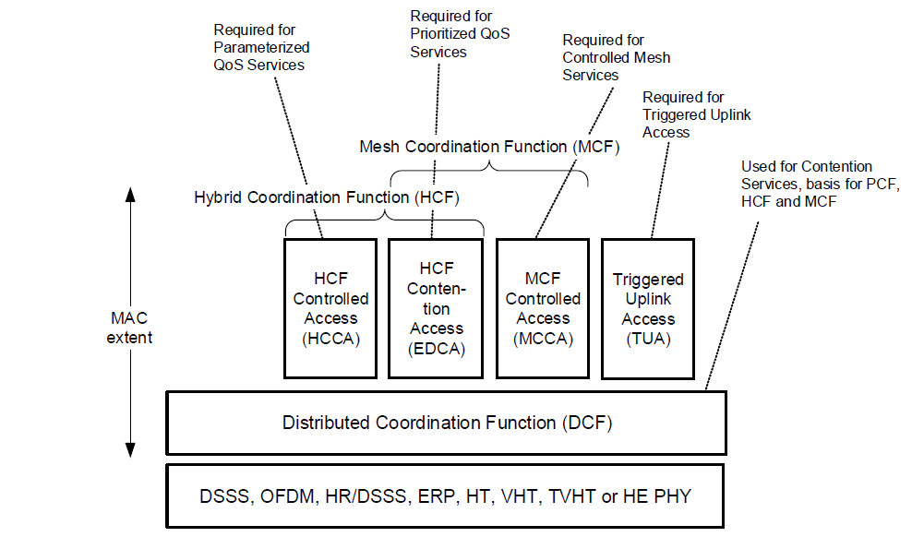
IEEE 802.11-2020 & IEEE 802.11ax-2020 WLAN MAC & PHYs HT/VHT/HE STA MAC architecture
Figure 10-1—Non-DMG non-CMMG non-S1G STA MAC architecture
- HT/VHT/HE STA and mesh STA MAC architecture

Slide 44
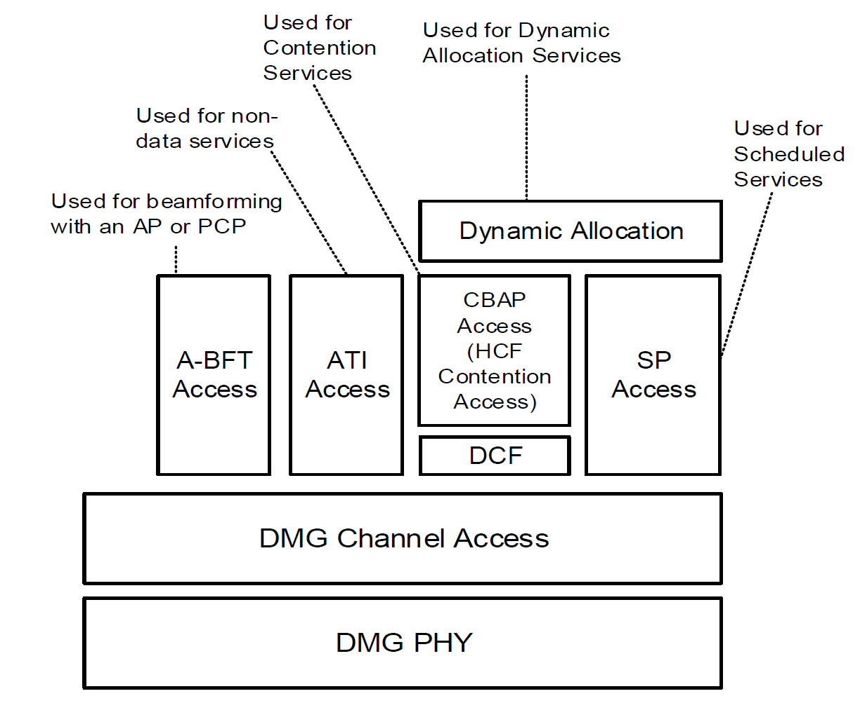
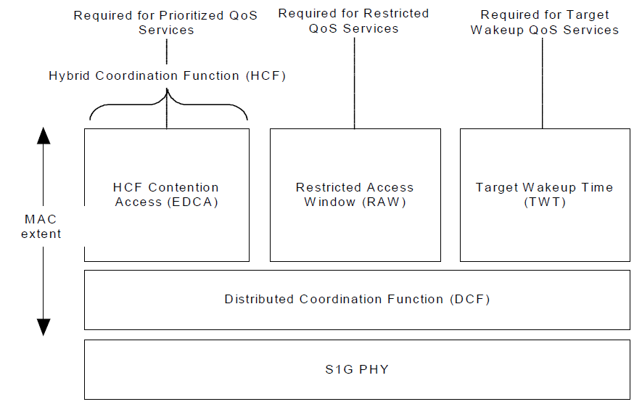
IEEE 802.11-2020 WLAN MAC & PHYs S1G STA and DMG STA MAC architecture
Figure 10-3—DMG STA and CMMG STA architecture
A-BFT the association beamforming training
ATI announcement transmission interval
CBAP contention-based access period
SP service period
Figure 10-2—S1G STA MAC architecture

Slide 45
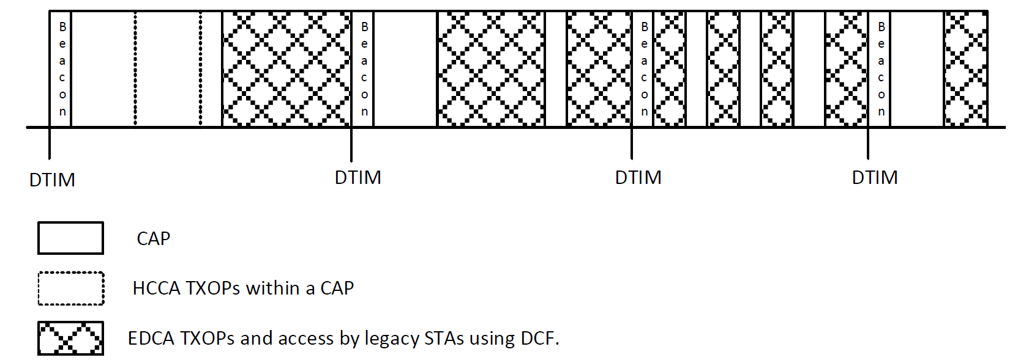
IEEE 802.11-2020 WLAN MAC & PHYs Frames
HCCA (CAP)
- The HCF gets higher priority than EDCA
EDCA
CAP (Controlled Access Phase)
DTIM (Delivery Traffic Indication Map)
TIM (traffic indication map)
EDCA (Enhanced Distributed Channel Access)
HCCA (HCF Controlled Channel Access)
HCF (hybrid coordination function)
TXOP (Transmission Opportunity)
Figure 10-29—CAP periods

Slide 46
IEEE 802.11-2020 WLAN MAC & PHYs Carrier Sensing (CS) mechanism
CS mechanism
Physical and virtual CS functions are used to determine the state of the medium (IDLE/BUSY).
When either function indicates a busy medium, the medium shall be considered busy.
Otherwise, it shall be considered idle.

Slide 47
IEEE 802.11-2020 WLAN MAC & PHYs Physical CS function
A physical CS mechanism shall be provided by the PHY.
The MAC shall issue a PHY-CCARESET.request (IPI-STATE) to the PHY.
The parameter value is IPI-ON when the MAC sublayer is requesting the PHY entity to report IPI values when the PHY is neither receiving nor transmitting a PPDU.
IPI idle power indicator

Slide 48
IEEE 802.11-2020 WLAN MAC & PHYs Physical CS function
A physical CS mechanism shall be provided by the PHY.
A PHY-CCA.indication (STATE, IPI-REPORT, channel-list) is an indication by the PHY to the local MAC entity of the current state of the medium and to provide observed IPI values when IPI reporting is turned on.
The STATE parameter can be one of two values: BUSY or IDLE.
It is BUSY if the assessment of the channel(s) by the PHY determines [that the channel(s) are not available].
The IPI-REPORT parameter is present if dot11RadioMeasurementActivated is true and if IPI reporting has been turned on by the IPI-STATE parameter.
The channel-list parameter carries a set (indicating which channels are busy).
When STATE is IDLE or when, for the type of PHY in operation, CCA is determined by a single channel, the channel-list parameter is absent.
IPI idle power indicator

Slide 49
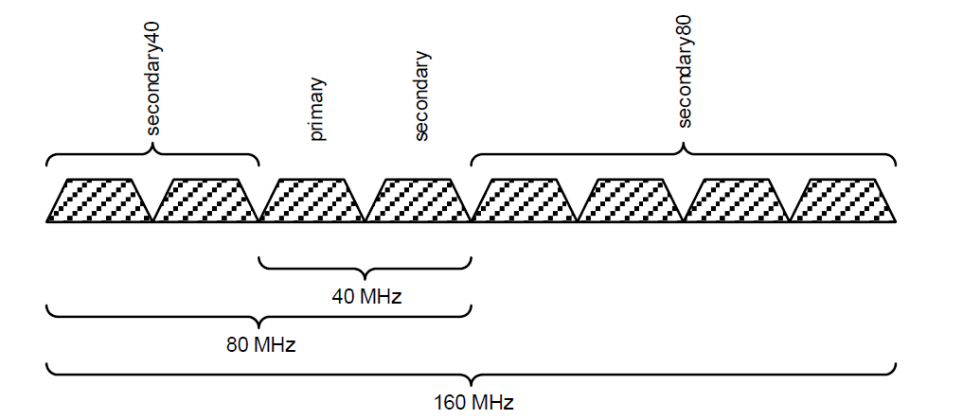
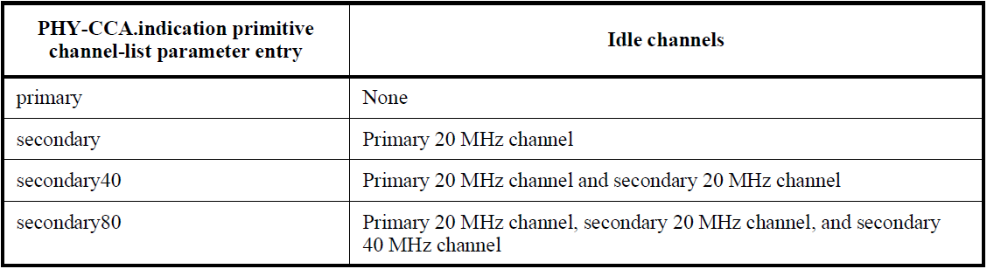
IEEE 802.11-2020 WLAN MAC & PHYs Physical CS function
Figure 8-1—The channel-list parameter entry for 40 MHz, 80 MHz, and 160 MHz channel width
Table 10-17—Channels indicated idle by the channel-list parameter for VHT or TVHT BSSs

Slide 50
IEEE 802.11-2020 WLAN MAC & PHYs Virtual CS function
The Virtual CS function shall be provided by the MAC.
It is referred to as the NAV (Network Allocation Vector).
The NAV may be thought of as a counter, which counts down to 0 at a uniform rate.
The NAV maintains a prediction of future traffic on the medium based on duration information (the Duration field in a MAC frame)
The duration information is also available Duration field in the MAC headers of all frames

Slide 51
IEEE 802.11-2020 WLAN MAC & PHYs Virtual CS function
Some types of STA may maintain multiple NAVs.
HE STA (IEEE 802.11ax-2021) maintains two NAVs.
An intra-BSS NAV
the medium is BUSY due to communication between intra-BSS STAs within an BSS.
AN inter-BSS NAV
the medium is BUSY due to communication between inter-BSS (OBSS) STAs.
The medium is ILDE if both NAVs are (0s).
OBSS Overlapping BSS

Slide 52
IEEE 802.11-2020 WLAN MAC & PHYs 10.3.2.4 Setting and resetting the NAV
A STA [that receives at least one valid frame in a PSDU] can update its NAV with the information from any valid Duration field in the PSDU.
The STA shall update its NAV when the received Duration is greater than the STA’s current NAV value.
Upon receipt of a PS-Poll frame, a STA shall update its NAV settings as appropriate under the data rate selection rules using a duration value (equal to the time required to transmit one Ack frame plus one SIFS).
This NAV update operation is performed when the PHY-RXEND.indication primitive is received.

Slide 53
IEEE 802.11-2020 WLAN MAC & PHYs 10.3.5 Individually addressed MPDU transfer procedure
A STA shall use an RTS/CTS preceding a frame exchange [including an individually addressed Data or Management frame] when the length of the PSDU > dot11RTSThreshold.
If dot11RTSThreshold is 0, an RTS/CTS exchange precedes all frame exchanges [including an individually addressed Data or Management frame].
A STA may also use an RTS/CTS exchange for individually addressed frames when it is necessary to distribute the NAV, or when it is necessary to establish protection, or for other purposes.

Slide 54
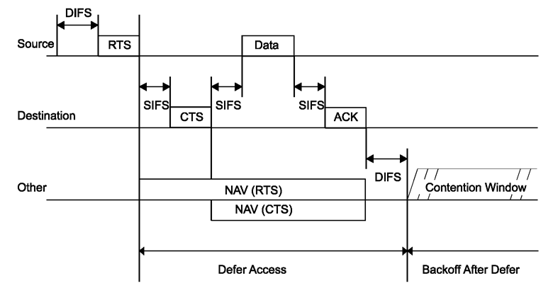
IEEE 802.11-2020 WLAN MAC & PHYs 10.3.2.4 Setting and resetting the NAV
Figure 10-6—RTS/CTS/data/Ack and NAV setting
NAV (Network Allocation Vector)

Slide 55
IEEE 802.11 CSMA/CA RTS/CTS reservation mechanism
The exchange of RTS and CTS frames prior to the actual Data frame is one means of distribution of this medium reservation information
The RTS/CTS exchange also performs both a type of fast collision inference and a transmission path check.
Another advantage of the RTS/CTS mechanism occurs where multiple BSSs utilizing the same channel overlap.

Slide 56
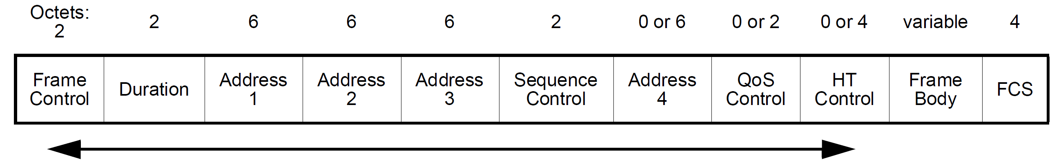
IEEE 802.11-2020 WLAN MAC & PHYs MAC-Level Acknowledgements
The reception of some frames requires the receiving STA to respond with an acknowledgment if the FCS of the received frame is correct.
The QoS Control field (16bits) is present in all QoS Data frames.
Ack Policy Indicator subfield (Bit5..bit7) of QoS Control field in a MAC header
Normal Ack (00) The addressed recipient returns an Ack.
Implicit BAR (00) The addressed recipient returns a BlockAck.
This MPDU is sent under a block ack agreement.
No Ack (10) The addressed recipient takes no action upon receipt of the frame.
No Explicit Acknowledgment (01) (Subtype(b7..b4): b6(1) no Frame Body field.
PSMP Ack (01) (Subtype(b7..b4):b6(0)) Frame(PSMP-DTT)→PSMP Ack(PSMP-UTT); Frame(PSMP-UTT)→PSMP Ack(PSMP-DTT)
Block Ack (11) (a) The addressed recipient takes no action upon the receipt of the frame except for recording the state. (b) The recipient can expect a BlockAckReq (BAR) frame or implicit block ack request in the future.
PSMP-DTT power save multi-poll downlink transmission time
PSMP-UTT power save multi-poll uplink transmission time
subtype

Slide 57
IEEE 802.11-2020 WLAN MAC & PHYs 10.3.2.3 IFS (interframe space)
The time interval between frames is called the IFS.
A STA shall determine [that the medium is idle through the use of the CS function for the interval specified.
Ten different IFSs are defined to provide priority levels for access to the wireless medium.
Why are IFSs priority levels for channel access?
Several stations determine the state of a medium simultaneously (CSMA).
A station with shorter IFS (higher priority) takes the access right of the medium, and transmits its frame.
Others defer access to the medium as the state of the medium becomes busy.

Slide 58
IEEE 802.11-2020 WLAN MAC & PHYs 10.3.2.3 IFS (interframe space)
The DCF at the transmitting STA invokes the backoff procedure at the end of transmission (backoff count = n)
Figure 10-16—Basic access method

Slide 59
IEEE 802.11-2020 WLAN MAC & PHYs 10.3.2.3 IFS (interframe space)
AP STA:
AIFS[AC]≥PIFS
HCF for HCCA: PIFS
non-AP STA:
AIFS[AC]≥DIFS
if the medium state is BUSY,
the DCF invoke the backoff procedure
(backoff count = n)
Figure 10-5—Some IFS relationships

Slide 60
IEEE 802.11-2020 WLAN MAC & PHYs 10.3.2.3 IFS (interframe space)
SIFS (Short IFS)
SIFS = aSIFSTime
The IFS for succeeding frames in a sequence of transmission.
PIFS (Priority IFS)
PIFS = SIFS+aSlotTime
Beacon frame (AP),
Hybrid Coordination Function (HCF) for Controlled Access Period
DIFS (DCF IFS)
DIFS = SIFS+2*aSlotTime = PIFS+ aSlotTime
User or management frames (DCF:CSMA/CA)

Slide 61
IEEE 802.11-2020 WLAN MAC & PHYs 10.3.2.3 IFS (interframe space)
EIFS (Extended IFS)
(DCF) EIFS= SIFS+(Estimated)ACKTxTime+DIFS
(Estimated) ACKTxTime (μs) : the time required to transmit an ACK frame at the lowest PHY mandatory rate.
Table 10-8—Determination of the EstimatedAckTxTime based on properties of the PPDU causing the EIFS
The DCF shall use EIFS before transmission after the reception of an erroneous frame.

Slide 62
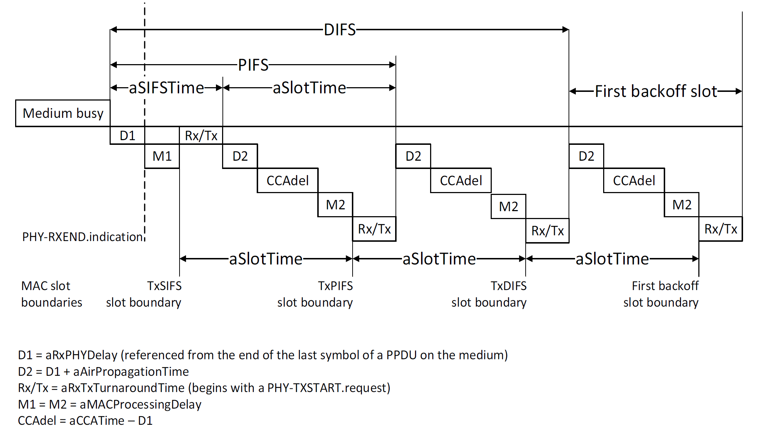
IEEE 802.11-2020 WLAN MAC & PHYs 10.3.7 DCF timing relations
PHY-CCARESET.request
PHY-CCA.indication((IDLE)/(BUSY,channel-list))
Figure 10-21—DCF timing relationships

Slide 63
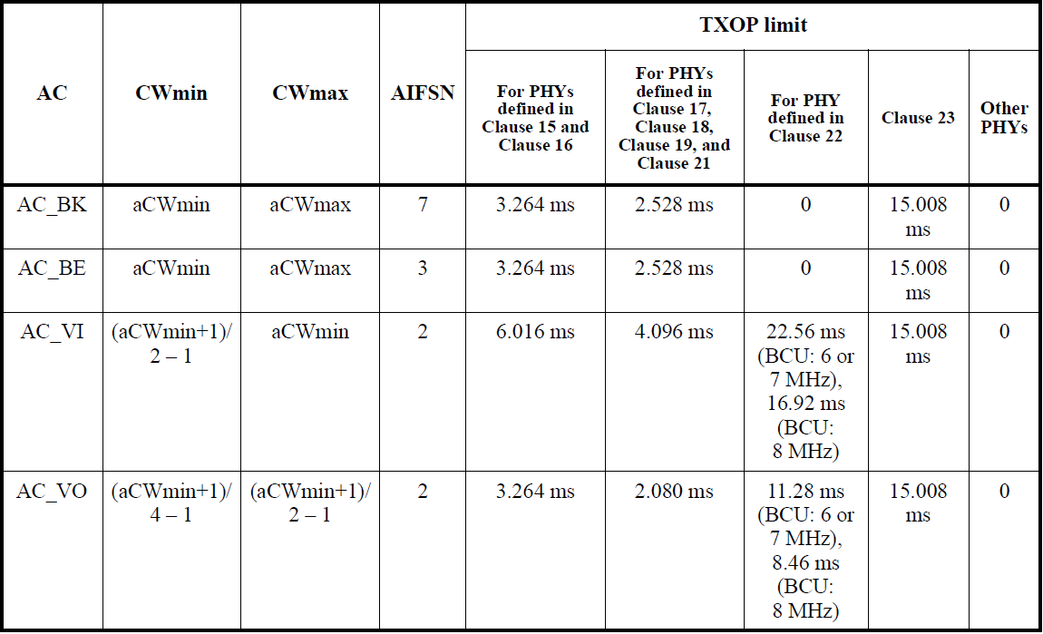
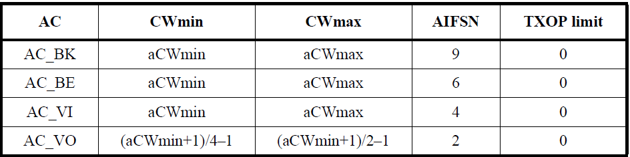
IEEE 802.11-2020 WLAN MAC & PHYs 10.3.2.3 IFS (interframe space) IFS for EDCA (enhanced distributed channel access)
Table 9-155—Default EDCA Parameter Set element parameter values
if dot11OCBActivated is false or the STA is a non-sensor STA
Table 9-156—Default EDCA parameter set for STA operation if dot11OCBActivated is true (IEEE 802.11p)
DSSS
HR/DSSS
OFDM, ERP
HT, VHT
TVHT
S1G

Slide 64
IEEE 802.11-2020 WLAN MAC & PHYs DCF (CSMA/CA)
The CSMA/CA protocol is designed to reduce the collision probability between multiple STAs accessing a medium, at the point where collisions would most likely occur
(Just after the medium becomes idle following a busy medium) is (when the highest probability of a collision exists)
This is the situation that necessitates a random backoff procedure to resolve medium contention conflicts.

Slide 65
IEEE 802.11-2020 WLAN MAC & PHYs 10.3.4 DCF access procedure (CSMA/CA) 10.3.4.2 Basic access
A STA may transmit an MPDU, when the STA determines that (a) the medium is idle when a frame is queued for transmission, and (b) remains idle for a period of a DIFS or an EIFS from the end of the immediately preceding medium-busy event, whichever is the greater, and the backoff counter has a value of zero.
Otherwise the random backoff procedure (for DCF) shall be followed.

Slide 66
IEEE 802.11-2020 WLAN MAC & PHYs 10.3.2.3 IFS (interframe space) IFS for EDCA (enhanced distributed channel access)
AIFS (Arbitration IFS; AIFS[AC])
AIFS[AC]=SIFS+AIFSN[AC]*aSlotTime
A STA [using the EDCAF] shall obtain a TXOP for an AC if the STA’s CS mechanism determines [that the medium is idle at the AIFS[AC] slot boundary, after a correctly received frame, and the backoff counter for that AC has a value of zero.
EIFS for EDCA
(DCF: EIFS= SIFS+(Estimated)ACKTxTime+DIFS)
EIFS–DIFS+AIFS[AC] = SIFS+(Estimated)ACKTxTime+AIFS[AC]
AC access category

Slide 67
IEEE 802.11-2020 WLAN MAC & PHYs 10.3.4 DCF access procedure (CSMA/CA) 10.3.4.2 Basic access
The DCF of the transmitting STA invokes the backoff procedure at the end of transmission even if no additional transmissions are currently queued (backoff count = n)
(backoff count = 0)
if the medium state is BUSY,
the DCF invoke the backoff procedure
(backoff count = n)
Figure 10-16—Basic access method

Slide 68
IEEE 802.11-2020 WLAN MAC & PHYs 10.3.3 Random backoff procedure
A STA [desiring to initiate transfer of Data frames and/or Management frames using the DCF] shall invoke the CS mechanism to determine the busy/idle state of the medium.
If the medium is busy, the STA shall defer until the medium is determined to be idle without interruption for a period of time equal to a DIFS or EIFS, as appropriate.
After this DIFS or EIFS medium idle time, the STA shall then generate a random backoff count for an additional deferral time before transmitting, unless the backoff counter already contains a nonzero value.
This process minimizes collisions during contention between multiple STAs that have been deferring to the same event.

Slide 69
IEEE 802.11-2020 WLAN MAC & PHYs 10.3.3 Random backoff procedure
Every STA shall maintain a contention window (CW), a STA short retry count (SSRC) and a STA long retry count (SLRC).
The contention window (CW) shall take an initial value of aCWmin.
The SSRC and the SLRC shall take an initial value of 0.
Every time an unsuccessful attempt to transmit an MPDU,
The CW shall take the next value [(CW+1)*2-1] (every time an unsuccessful attempt to transmit an MPDU) until the CW reaches the value of aCWmax.
(a PSDU length ≤ dot11RTSThreshold) SSRC is increased until SSRC reaches dot11ShortRetryLimit.
(a PSDU length > dot11RTSThreshold) SLRC is increased until SSRC reaches dot11LongRetryLimit.

Slide 70
IEEE 802.11-2020 WLAN MAC & PHYs 10.3.3 Random backoff procedure
Figure 10-15—Example of exponential increase of CW

Slide 71
IEEE 802.11-2020 WLAN MAC & PHYs 10.3.3 Random backoff procedure
If the transmission is successful,
The CW value reverts to aCWmin before the random backoff count is chosen, and
The SSRC and/or SLRC shall be reset to 0.

Slide 72
IEEE 802.11-2020 WLAN MAC & PHYs 10.3.4 DCF access procedure (CSMA/CA) 10.3.4.3 Backoff procedure for DCF
(1) A STA shall invoke the backoff procedure to transfer a frame when finding the medium busy as indicated by either the physical or virtual CS mechanism.
(2) A transmitting STA shall invoke the backoff procedure when the STA infers a failed transmission.

Slide 73
IEEE 802.11-2020 WLAN MAC & PHYs 10.3.4 DCF access procedure (CSMA/CA) 10.3.4.3 Backoff procedure for DCF
(3) A backoff procedure shall be performed immediately after the end of every transmission of an MPDU [with the Type subfield equal to Data, Management, or Control with subtype PS-Poll], even if no additional transmissions are currently queued.
In the case of successful acknowledged transmissions, this backoff procedure shall begin at the end of the received Ack frame.
In the case of unsuccessful transmissions requiring an immediate response, this backoff procedure shall begin at the end of the AckTimeout interval or CTSTimeout interval.

Slide 74
IEEE 802.11-2020 WLAN MAC & PHYs 10.3.4 DCF access procedure (CSMA/CA) 10.3.4.3 Backoff procedure for DCF
To begin the backoff procedure, the STA shall set its backoff counter to a random value using Backoff Count = Random().
Random() = Pseudorandom integer drawn from a uniform distribution over the interval [0,CW].
A STA shall use the CS mechanism to determine whether there is activity during each backoff slot.
All backoff slots occur following a DIFS or EIFS as appropriate.

Slide 75
IEEE 802.11-2020 WLAN MAC & PHYs 10.3.4 DCF access procedure (CSMA/CA) 10.3.4.3 Backoff procedure for DCF
If no medium activity is indicated for the duration of a particular backoff slot, then the backoff procedure shall decrement its backoff counter.
If the medium is determined to be busy at any time during a backoff slot, then the backoff counter shall not be decremented for that slot. (suspension)
The backoff counter is next decremented after the medium has been determined to be idle for the duration of [(a DIFS or EIFS, as appropriate) plus aSlotTime]. (resumption)
Transmission shall commence when the backoff counter equals 0.

Slide 76
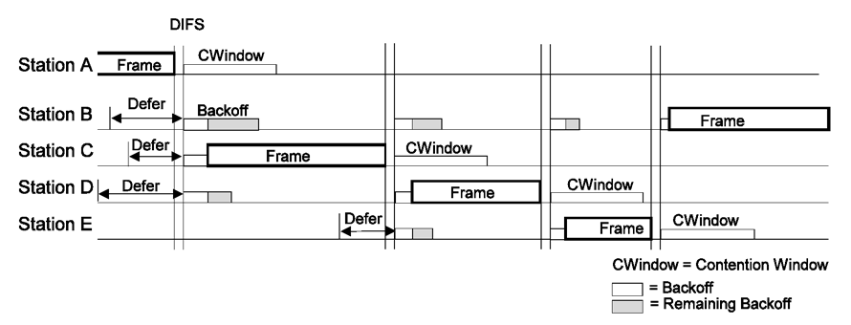
IEEE 802.11-2020 WLAN MAC & PHYs 10.3.4 DCF access procedure (CSMA/CA) 10.3.4.3 Backoff procedure for DCF
Backoff Procedure is suspended
Backoff Procedure immediately after the end of every transmission
Backoff Procedure is resumed

Slide 77
IEEE 802.11-2020 WLAN MAC & PHYs 10.23 HCF (Hybrid Coordination Function) 10.23.1 General
Under HCF, the basic unit of allocation of the right to transmit onto the WM is the TXOP.
Each TXOP is defined by a starting time and a defined maximum length.
In a non-DMG BSS, the TXOP may be obtained
by a STA winning an instance of EDCA contention (EDCA TXOP) or
by a STA receiving a QoS (+)CF-Poll frame (HCCA TXOP or polled TXOP).
HCCA is not used by either DMG or S1G STAs.
TXOP transmission opportunity
QoS quality of service
CF-Poll contention free poll

Slide 78
IEEE Std 802.11-2020 & 802.11ax-2021 10.23.2 HCF contention based channel access (EDCA) 10.23.2.1 Reference model
The EDCA channel access protocol is derived from the DCF procedures by adding four independent enhanced distributed channel access functions (EDCAFs) to provide differentiated priorities to transmitted traffic, through the use of four different access categories (ACs).

Slide 79
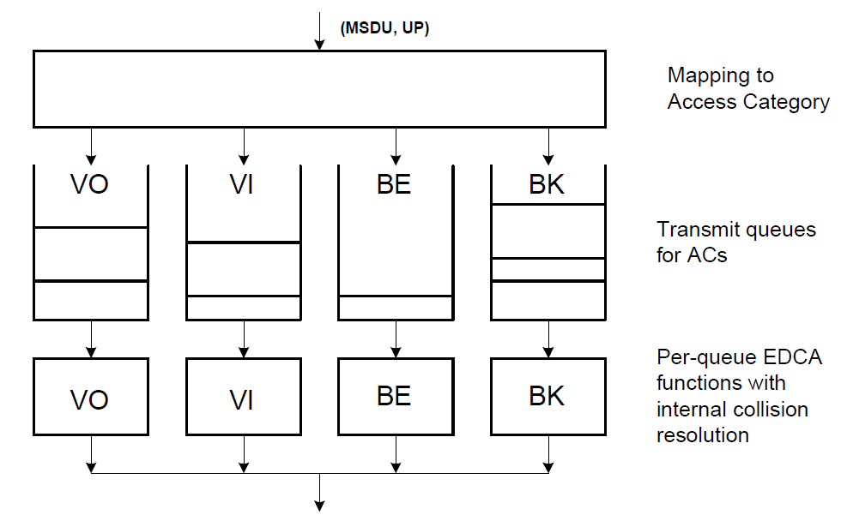
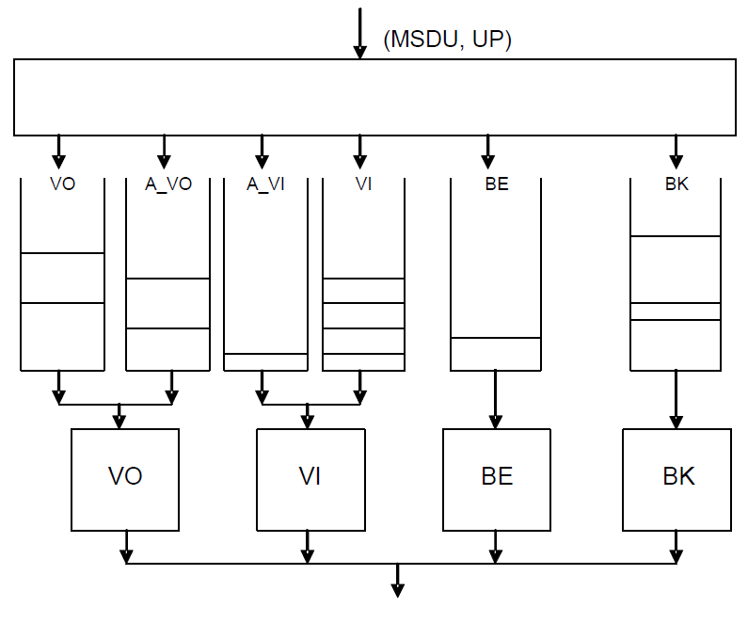
IEEE Std 802.11-2020 & 802.11ax-2021 10.23.2 HCF contention based channel access (EDCA) 10.23.2.1 Reference model
Figure 10-23—Reference implementation model when dot11AlternateEDCAActivatedis false or not present
Figure 10-24—Reference implementation model when dot11AlternateEDCAActivated is true

Slide 80
IEEE Std 802.11-2020 & 802.11ax-2021 10.23.2 HCF contention based channel access (EDCA) 10.23.2.2 EDCA backoff procedure
The TXNAV timer is a single timer, shared by the EDCAFs within a STA.
It is initialized with the duration from the Duration/ID field in the frame most recently successfully transmitted by the TXOP holder, except for PS-Poll frames.
The TXNAV timer begins counting down from the end of the transmission of the PPDU containing that frame.
PS power save (mode)

Slide 81
IEEE Std 802.11-2020 & 802.11ax-2021 10.23.2 HCF contention based channel access (EDCA) 10.23.2.2 EDCA backoff procedure
The backoff procedure shall be invoked by an EDCAF if any of the following events occurs:
a) An MA-UNITDATA.request primitive is received that causes an MPDU corresponding to the EDCAF’s AC to be queued for transmission such that all of the following are true:
1) One of the transmit queues (AC or Alternate AC) associated with that AC has now become non-empty
2) Any other transmit queues associated with that AC are empty
3) The backoff counter has a value of 0 for that AC
4) The medium is busy on the primary channel as indicated by any of the following:
Physical CS or Virtual CS (NAV)
A nonzero TXNAV timer value

Slide 82
IEEE Std 802.11-2020 & 802.11ax-2021 10.23.2 HCF contention based channel access (EDCA) 10.23.2.2 EDCA backoff procedure
The backoff procedure shall be invoked by an EDCAF … :
b) For the EDCAF [that is the TXOP holder], the transmission of the final PPDU [transmitted by the TXOP holder during the TXOP] has completed, and the TXNAV timer has expired.
c) For the EDCAF [that is the TXOP holder], the transmission of an MPDU in the initial PPDU of a TXOP fails,
d) A transmission attempt by the EDCAF collides internally with another EDCAF of an AC that has higher priority, [that is, two or more EDCAFs in the same STA are granted a TXOP at the same time].
initial/non-initial PPDU
final PPDU
Duration
TXNAV

Slide 83
IEEE Std 802.11-2020 & 802.11ax-2021 10.23.2 HCF contention based channel access (EDCA) 10.23.2.3 EDCA TXOPs
Three modes of EDCA TXOP
Initiation of an EDCA TXOP
The EDCA rules permit access to the medium.
Sharing an EDCA TXOP
An EDCAF within an AP [that supports DL-MU-MIMO] has obtained access to the medium, making the corresponding AC the primary AC, and includes traffic from queues associated with other ACs in VHT MU PPDUs transmitted during the TXOP.
Multiple frame transmission within an EDCA TXOP
An EDCAF retains the right to access the medium following the completion of a frame exchange sequence, such as on receipt of an Ack frame.
DL-MU-MIMO downlink multi-user multiple input, multiple output

Slide 84
IEEE Std 802.11-2020 & 802.11ax-2021 10.23.2.3 EDCA TXOPs 10.23.2.4 Obtaining an EDCA TXOP
Each EDCAF shall maintain a backoff counter.
A backoff counter has a value measured in backoff slots.
When the backoff procedure is invoked, the backoff counter is set to an integer value chosen randomly with a uniform distribution taking values in the range 0 to CW[AC].
The duration AIFS[AC] is a duration derived from the value AIFSN[AC] by the relation:
AIFS[AC] = aSIFSTime + AIFSN[AC] × aSlotTime
AIFS[AC] slot boundary = AIFS[AC] – aRxTxTurnaroundTime.
EIFS[AC] slot boundary = EIFS–DIFS+AIFS[AC]– aRxTxTurnaroundTime.
DL-MU-MIMO downlink multi-user multiple input, multiple output

Slide 85
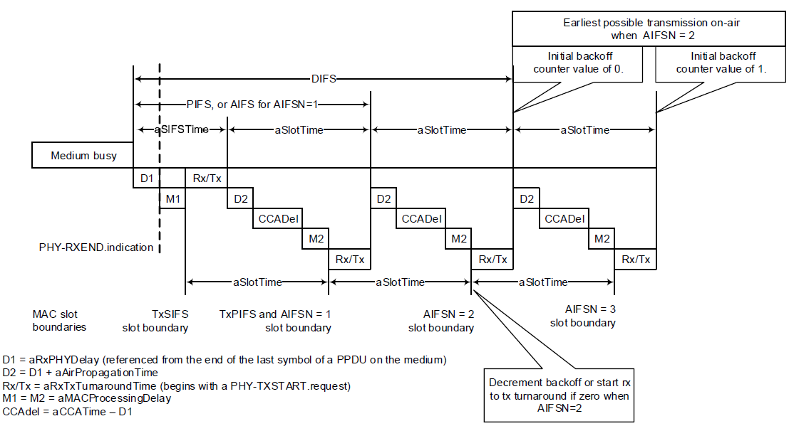
IEEE 802.11-2020 WLAN MAC & PHYs 10.23.2.3 EDCA TXOPs 10.23.2.4 Obtaining an EDCA TXOP
Figure 10-25—EDCA mechanism timing relationships

Slide 86
IEEE Std 802.11-2020 & 802.11ax-2021 10.23.2.3 EDCA TXOPs 10.23.2.4 Obtaining an EDCA TXOP
EDCAF operations shall be performed at slot boundaries, [defined as follows on the primary channel,] for each EDCAF:
(the original conditions are simplified to help understanding of EDCAF op.)
[a)&b) the STA is received a frame]
a) Following AIFS[AC] slot boundary of idle medium after the last busy medium on the antenna that was the result of a reception of a frame with a correct FCS.
It is not necessarily idle medium during the SIFS.
Medium[BUSY: RxFrame(NoError)]→Medium[IDLE: AIFS[AC] slot boundary]
b) Following EIFS[AC] slot boundary of idle medium after the last indicated busy medium as determined by the physical CS mechanism.
Medium[BUSY: RxFrame(Error)]→Medium[IDLE: EIFS[AC] slot boundary]

Slide 87
IEEE Std 802.11-2020 & 802.11ax-2021 10.23.2.3 EDCA TXOPs 10.23.2.4 Obtaining an EDCA TXOP
EDCAF operations shall be performed at slot boundaries, … :
[c)&d) the another EDCAF is transmitted a frame with/without ImmAck]
c) When any other EDCAF at this STA [transmitted a frame requiring immediate acknowledgment], the earlier of
1) (the AckTimeout interval + AIFS[AC] slot boundary) of idle medium, timed from the PHY-TXEND.confirm primitive, and
Medium[BUSY: TxFrame(ImmAck)(any other EDCAF)] → Medium[IDLE: AckTimeout+AIFS[AC] slot boundary]
2) the end of first AIFS[AC] slot boundary of idle medium when a PHY-RXEND.indication primitive occurs.
It is not necessarily idle medium during the SIFS.
Medium[BUSY: RxFrame(Ack)]→Medium[IDLE: AIFS[AC] slot boundary]

Slide 88
IEEE Std 802.11-2020 & 802.11ax-2021 10.23.2.3 EDCA TXOPs 10.23.2.4 Obtaining an EDCA TXOP
EDCAF operations shall be performed at slot boundaries, … :
d) Following AIFS [AC] slot boundary of idle medium after the last busy medium on the antenna that was the result of a transmission of a frame (not require an acknowledgment) for any EDCAF and after the expiration of the TXNAV timer if nonzero.
It is not necessarily idle medium during the SIFS.
Medium[BUSY: TxFrame(NoImmAck)(any EDCAF)] → Medium[IDLE: AIFS[AC] slot boundary & TXNAV(0)]

Slide 89
IEEE Std 802.11-2020 & 802.11ax-2021 10.23.2.3 EDCA TXOPs 10.23.2.4 Obtaining an EDCA TXOP
EDCAF operations shall be performed at slot boundaries, … :
[e) the EDCAF attempts to transmit a frame]
e) Following AIFS[AC] slot boundary of idle medium after the last indicated busy medium as indicated by the CS mechanism that is not covered by condition a) to condition d).
Medium[BUSY: the CS mechanism(NAV)] → Medium[IDLE: AIFS[AC] slot boundary]
[f) (DCF) backoff slots]
f) Following aSlotTime of idle medium, which occurs immediately after any of these conditions, a) to f), is met for the EDCAF.
Medium[IDLE: (a-e) AIFS[AC] slot boundary]+ aSlotTime x N. N≥1.

Slide 90
IEEE Std 802.11-2020 & 802.11ax-2021 10.23.2.3 EDCA TXOPs 10.23.2.4 Obtaining an EDCA TXOP
On these specific slot boundaries, each EDCAF shall make a determination to perform one and only one of the following functions:
Decrement the backoff counter.
Initiate the transmission of a frame exchange sequence.
Invoke the backoff procedure due to an internal collision.
Do nothing.

Slide 91
IEEE Std 802.11-2020 & 802.11ax-2021 10.23.2.3 EDCA TXOPs 10.23.2.4 Obtaining an EDCA TXOP
(The backoff counter for that EDCAF has a nonzero value)
Each EDCAF shall decrement the backoff counter.
(The backoff counter for that EDCAF has a value of 0)
Each EDCAF shall initiate a transmission sequence if
There is a frame available for transmission at that EDCAF, and
Initiation of a transmission sequence is not allowed to commence at this time for an EDCAF of higher UP.
Each EDCAF shall report an internal collision if
There is a frame available for transmission at that EDCAF, and
Initiation of a transmission sequence is allowed to commence at this time for an EDCAF of higher UP.

Slide 92
IEEE 802.15.4 Low-Rate Wireless Networks
Informational

Slide 93
IEEE 802.15.4-2020 LR-WPAN 5.2 Special application spaces
5.2.2 Smart utility network (SUN)
SUNs enable multiple applications to operate over shared network resources, providing monitoring and control of a utility system.
SUN devices are designed to operate in very large-scale, low-power wireless applications and often require using the maximum transmit power available under applicable regulations, in order to provide long-range, point-to-point connections.
5.2.3 Rail communications and control (RCC)
5.2.4 Television white space (TVWS)
5.2.5 Radio frequency identification (RFID)
5.2.6 Low-energy, critical infrastructure monitoring (LECIM)
5.2.7 Medical body area network (MBAN) services
5.2.8 China medical band (CMB)

Slide 94
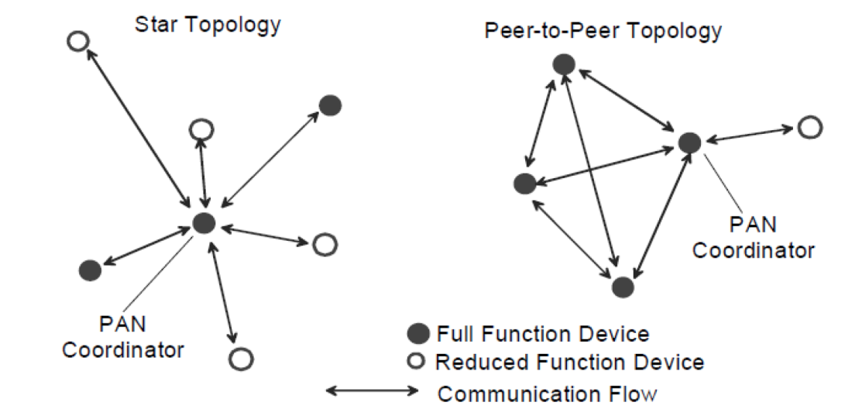
IEEE 802.15.4-2020 LR-WPAN 5.5 Network topologies
IEEE 802.15.4 LR-WPAN operates in either of two topologies:
the star topology or
the peer-to-peer topology

Slide 95
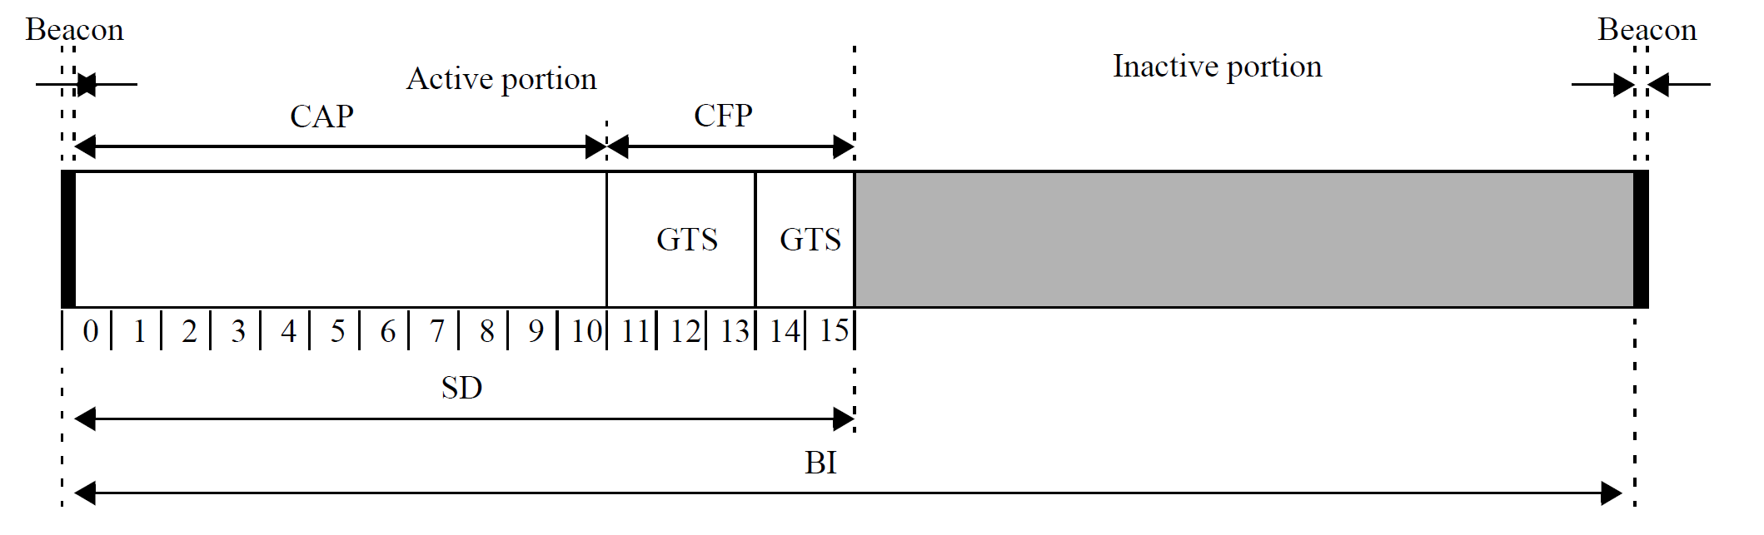
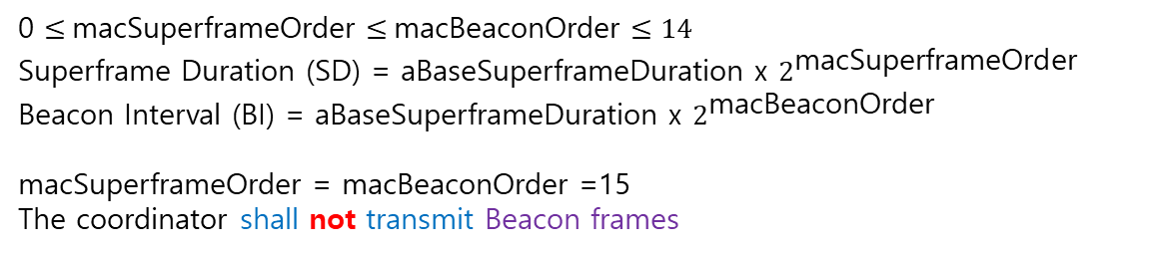
IEEE 802.15.4-2020 LR-Wireless Networks 6.2 Channel access 6.2.1 Superframe structure
0 $≤$macSuperframeOrder $≤$macBeaconOrder $≤14$
Superframe Duration (SD) = aBaseSuperframeDuration x $2^{\text{macSuperframeOrder}}$ Beacon Interval (BI) = aBaseSuperframeDuration x $2^{\text{macBeaconOrder}}$
macSuperframeOrder = macBeaconOrder =15
The coordinator shall not transmit Beacon frames
CAP (Contention Access Period)
CFP (Contention Free Period)
- GTS (Guaranteed Time Slot)
Figure 6-1—An example of the superframe structure

Slide 96
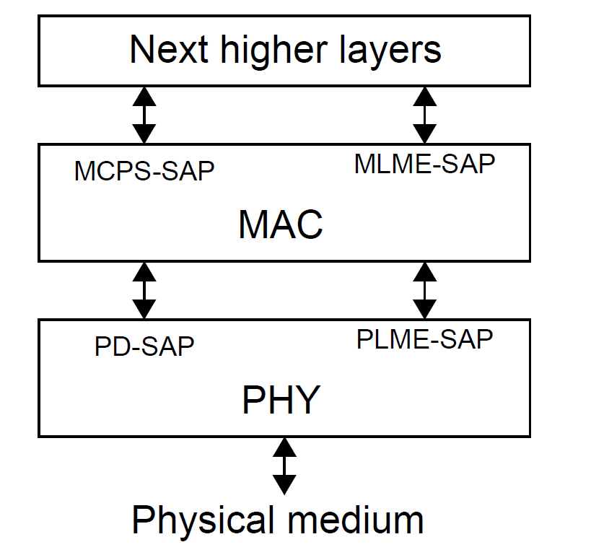
IEEE 802.15.4-2020 LR-Wireless Networks 5.6 Architecture
Figure 5-4—LR-WPAN device architecture

Slide 97
IEEE 802.15.4-2020 LR-Wireless Networks 6.2 Channel access 6.2.1.2 Contention access period (CAP)
The CAP shall start immediately following the beacon and complete before the beginning of the CFP on a superframe slot boundary.
If the CFP is zero length, the CAP shall complete at the end of the active portion of the superframe.
The CAP shall be at least aMinCapLength, and shall shrink or grow dynamically to accommodate the size of the CFP.

Slide 98
IEEE 802.15.4 LR-Wireless Networks 6.2 Channel access 6.2.1.3 Contention-free period (CFP)
The CFP shall start on a slot boundary immediately following the CAP, and it shall complete before the end of the active portion of the superframe.
If any GTSs have been allocated by the PAN coordinator, they shall be located within the CFP and occupy contiguous slots.
The duration of the CFP changes depending on the total duration of all of the combined GTSs.
No transmissions within the CFP shall use a CSMA-CA mechanism to access the channel.

Slide 99
IEEE 802.15.4-2020 LR-Wireless Networks 6.2 Channel access 6.2.1.4 Beacon only period (BOP)
When present, the BOP shall commence on the slot boundary immediately following CFP, if the CFP is present.
When there is no CFP, the BOP shall commence on the slot boundary immediately following the CAP.
The BOP shall complete before the end of the active portion of the superframe.
The BOP duration depends on the number of DBSs, one of which is allocated to each TMCTP-child PAN coordinator.
All DBSs shall be located within the BOP and occupy contiguous slots.
The BOP grows or shrinks depending on the total length of all of the combined DBSs.
CSMA-CA is not used for beacon transmissions in the BOP
DBS dedicated beacon slot
TMCTP TVWS multichannel cluster tree PAN
TVWS television white space

Slide 100
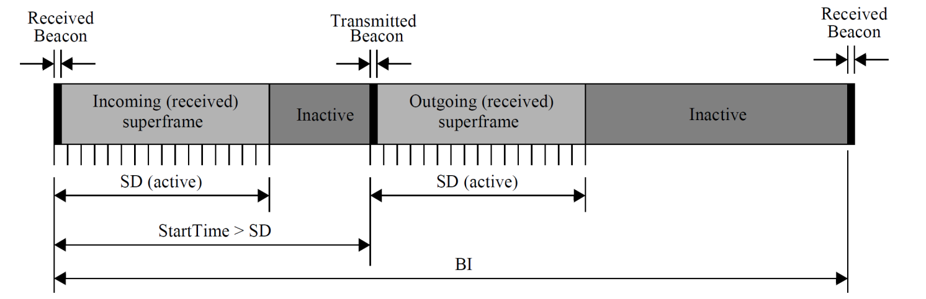
IEEE 802.15.4-2020 LR-Wireless Networks 6.2 Channel access 6.2.2 Incoming and outgoing superframe timing
On a beacon-enabled PAN, a coordinator [that is not the PAN coordinator] shall maintain the timing of both the superframe in which its coordinator transmits a beacon (the incoming superframe) and the superframe in which it transmits its own beacon (the outgoing superframe).
Figure 6-2—The relationship between incoming and outgoing beacons

Slide 101
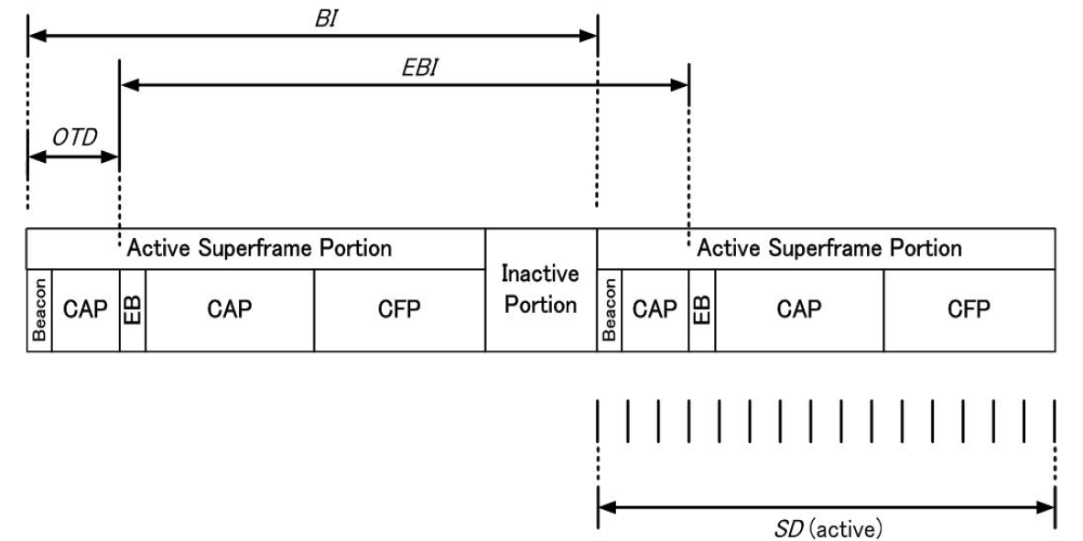
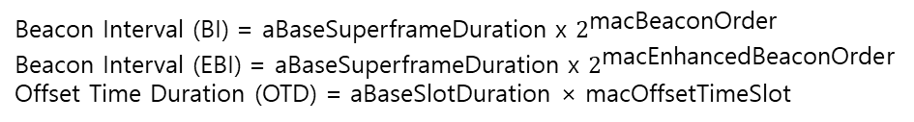
IEEE 802.15.4-2020 LR-Wireless Networks 6.2 Channel access 6.2.3 Enhanced Beacon frame timing for MPM procedure
In a beacon-enabled PAN, a SUN device (operating as a coordinator) transmits an Enhanced Beacon frame containing a Coexistence Specification IE at fixed intervals, in addition to the usual periodic beacons.
Beacon Interval (BI) = aBaseSuperframeDuration x $2^{\text{macBeaconOrder}}$
Beacon Interval (EBI) = aBaseSuperframeDuration x $2^{\text{mac}\text{Enhanced}\text{BeaconOrder}}$
Offset Time Duration (OTD) = aBaseSlotDuration × macOffsetTimeSlot
SUN smart utility network
MPM multi-PHY management
Figure 6-3—Timing information for Enhanced Beacon frames

Slide 102
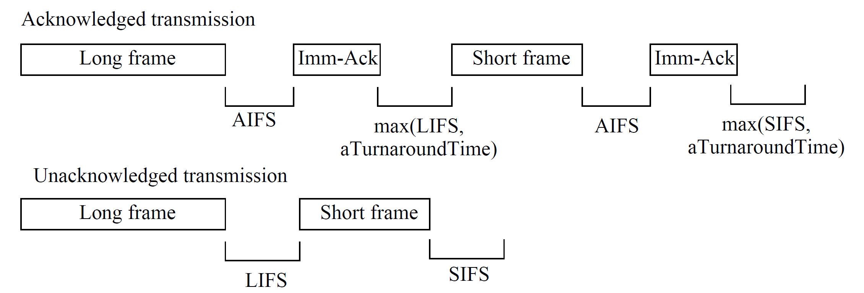
IEEE 802.15.4-2020 LR-Wireless Networks 6.2 Channel access 6.2.4 IFS
The MAC sublayer needs a finite amount of time to process data received by the PHY
IFS
Acknowledgment IFS (AIFS)
Long IFS (LIFS)
Frame size $>$ aMaxSifsFrameSize
max(macLifsPeriod, aTurnaroundTime).
Short IFS (SIFS)
Frame size $≤$ aMaxSifsFrameSize
max(macSifsPeriod, aTurnaroundTime)
AIFS $≤$ SIFS < LIFS
Figure 6-4—IFS usage
aTurnaroundTime
- RX-to-TX or TX-to-RX turnaround time

Slide 103
IEEE 802.15.4-2020 LR-Wireless Networks 6.2.5 Random access methods 6.2.5.1 CSMA-CA algorithm
The CSMA-CA algorithm shall be used before the transmission of data or MAC commands transmitted within the CAP.
If periodic beacons are being used in the PAN, the MAC sublayer shall employ the slotted version of the CSMA-CA algorithm for transmissions in the CAP of the superframe
If periodic beacons are not being used in the PAN or if a beacon could not be located in a beacon-enabled PAN, the MAC sublayer shall transmit using the unslotted version of the CSMA-CA algorithm.

Slide 104
IEEE 802.15.4-2020 LR-Wireless Networks 6.2.5 Random access methods 6.2.5.1 CSMA-CA algorithm
In both cases, the algorithm is implemented using units of time called backoff periods.
One backoff period shall be equal to aUnitBackoffPeriod.
aUnitBackoffPeriod : The number of symbols forming the basic time period used by the CSMA-CA algorithm.
For all PHYs except SUN PHYs operating in the 920 MHz band,
aTurnaroundTime +aCcaTime
For SUN PHYs operating in the 920 MHz band
aTurnaroundTime +phyCCADuration (smart utility network at 920MHz)

Slide 105
IEEE 802.15.4-2020 LR-Wireless Networks 6.2.5 Random access methods 6.2.5.1 CSMA-CA algorithm
Each device shall maintain three variables for each transmission attempt.
NB is the number of times the CSMA-CA algorithm was required to back off while attempting the current transmission
CW is the contention window length
defining the number of backoff periods that need to be clear of channel activity before the transmission can commence
slotted CSMA-CA only
BE is the backoff exponent,
how many backoff periods a device shall wait before attempting to assess a channel

Slide 106
IEEE 802.15.4-2020 LR-Wireless Networks 6.2.5 Random access methods 6.2.5.1 CSMA-CA algorithm
Note that if macMinBe is set to zero, collision avoidance will be disabled during the first iteration of this algorithm
Default CW=2
Default macMinBE=3 (0..3), macMaxBE=5
Default macMaxCSMABackoffs=4 (0..5)
Non-persistent
TSCH Time slotted channel hopping

